Slide 1
Computer Science II Advanced C++
Spring 2019

Slide 2
Pointers in C++
Intro to Pointers

Slide 3
Useful Links to C++ tutorial
There are some useful hints and illustrations on pointers in C++ at
http://www.cplusplus.com/doc/tutorial/pointers/

Slide 4
Variables and memory
So far, variables have been explained as locations in the computer's memory which can be accessed by their identifier (their name). This way, the program does not need to care about the physical address of the data in memory; it simply uses the identifier whenever it needs to refer to the variable
For a C++ program, the memory of a computer is like a succession of memory cells, each one byte in size, and each with a unique address. This way, each cell can be easily located in the memory by means of its unique address. For example, the memory cell with the address 1776 always follows immediately after the cell with address 1775 and precedes the one with 1777, and is exactly one thousand cells after 776 and exactly one thousand cells before 2776

Slide 5
Variables and memory
When a variable is declared, the memory needed to store its value is assigned a specific location in memory (its memory address)
Generally, C++ programs do not actively decide the exact memory addresses where its variables are stored. Fortunately, that task is left to the environment where the program is run - generally, an operating system that decides the particular memory locations on runtime
However, it may be useful for a program to be able to obtain the address of a variable during runtime in order to access data cells that are at a certain position relative to it

Slide 6
Variables and memory
Let say we declare one variable named num of type integer and assign an initial value as follows: int num = 7;
Then the variable is stored at a specific memory address and as an illustration, can be depicted as follows:
Memory address
1000
1004
1008
1012
1016
1020
7
Variable stored value
num
Variable name

Slide 7
Memory address
Normally the number is in hexadecimal (base 16) format because computer numbering system is based on binary format and this binary format can be simplified by using hexadecimal representation Example: 0028FFIC, 0028FF08
Hexadecimal digits: 0, 1, 2, 3, 4, 5, 6, 7, 8, 9, A, B, C, D, E, F

Slide 8
Address-of operator (&)
The address of a variable can be obtained by preceding the name of a variable with an ampersand sign (&), known as address-of operator. For example:
numPtr = &num
This would assign the address of variable num to numPtr
By preceding the name of the variable num with the address-of operator (&), we are no longer assigning the content of the variable itself to numPtr, but its address

Slide 9
Getting the Address of a Variable
Each variable in program is stored at a unique address
Use address operator & to get address of a variable:
int num = -99;
cout << &num; // prints address
// in hexadecimal

Slide 10
Pointer Variables
Pointer variable : Often just called a pointer, it's a variable that holds an address
Because a pointer variable holds the address of another piece of data, it "points" to the data

Slide 11
Address of the variable
Let us declare another variable to hold the memory address of variable num
Let say gives it a name, numPtr int *numPtr;
Memory address
1000
1004
1008
1013
1017
1021
?
7
Second variable
numPtr
num

Slide 12
Pointer
Let’s assign the address of the variable num to pointer variable numPtr numPtr = &num;
*numPtr
1000
1005
1009
1013
1017
1021
1013
7
numPtr
num

Slide 13
Pointer
Graphical explanation of a pointer
int num = 7;
int *numPtr;
numPtr = &num;
numPtr
num
7

Slide 14
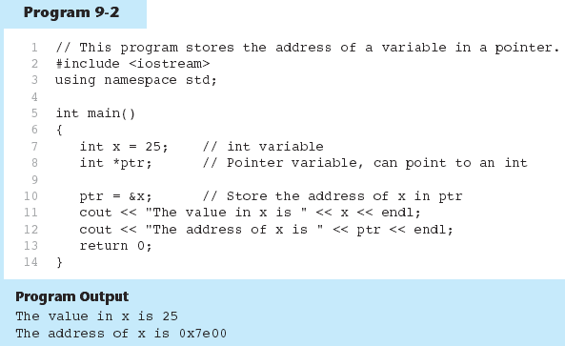

Slide 15
The idea of pointers
Assume: value1 and value2 are declared as integers and initialized to the values of 10 and 20. p1 and p2 are defined as pointers
&value1 and &value2 represents memory addresses of the variables
&value1 points to the box containing the integer 10
&value2 points to the box containing the integer 20
p1
value1
10
&value1
p2
value2
20
&value2

Slide 16
The idea of pointers
p1 and p2 are pointer variables
We can assign them at any time to point to data in the computer memory
p1 = &value1;
p2 = &value2;
p1
value1
10
&value1
p2
value2
value2
20
&value2

Slide 17
The idea of pointers
We can assign p1 to p2
p2 = p1;
Now, p1, p2, and &value1point to the value 10.
p1 and p2 are pointer variables
p1
value1
10
&value1
p2
value2
20
&value2

Slide 18
Pointer Variables
Definition:
int *intptr;
Read as:
“intptr can hold the address of a variable whose type is int”
Spacing in definition does not matter:
int * intptr; // same as above
int* intptr; // same as above

Slide 19
Pointer declaration
Syntax of a pointer declaration
Type_specifier * identifier
A compiler must know what type of data the pointer is pointing to first
Example:
int *IntPointer
The variable IntPointer is a pointer to an integer
The asterisk * in front of IntPointer instructs the compiler that IntPointer is a pointer variable pointing to an integer, but not a variable of type integer

Slide 20
Pointer declaration
These are three declarations of pointers. Each one is intended to point to a different data type
int * Integer_Pointer;
char * Character_Pointer;
double * Float_Pointer;
In fact, all of them are pointers and all of them occupy the same amount of space in memory (the size in memory of a pointer depends on the platform where the program runs)

Slide 21
Pointer declaration
int * Integer_Pointer;
char * Character_Pointer;
double * Float_Pointer;
all of them are pointers and all of them occupy the same amount of space in memory (the size in memory of a pointer depends on the platform where the program runs)
Nevertheless, the data to which they point to do not occupy the same amount of space nor are of the same type: the first one points to an int, the second one to a char, and the last one to a double

Slide 22
Pointer and Dereference Operator
The * is used in two different contexts
1) for declaration a variable as a pointer
Example int *yPtr;
here *yPtr is used to declare a pointer
2) to access to a value, which is pointed by a pointer
Example cout << *yPtr;
here *yPtr is used as a dereference operator to access a variable stored in the address contained in yPtr

Slide 23
Pointer and dereference operator
The dereference operator * can be read and understood as “a value pointed to by"
Therefore, the last statement of the following sequence:
int num=7;
int *numPtr;
numPtr = &num;
baz = *numPtr;
could be read as: "baz equal to the value pointed to by numPtr“

Slide 24
Pointer and dereference operator
Since numPtr points to the memory location containing 7, then after
baz = *numPtr;
baz becomes equal to 7
*numPtr
1000
1005
1009
1013
1017
1021
1013
7
7
numPtr
num
baz

Slide 25
Pointer and Dereference Operator
Thus the asterisk (*) used when declaring a pointer only means that it is a pointer (it is part of its type compound specifier)
It should not be confused with the dereference operator, which is also written with an asterisk (*)
They are simply two different things represented with the same sign

Slide 26
The Dereference (Indirection) Operator
The dereference (indirection) operator (*) dereferences a pointer
It allows you to access the item that the pointer points to: int x = 25; int *intptr = &x; cout << *intptr << endl;
This prints 25.

Slide 27
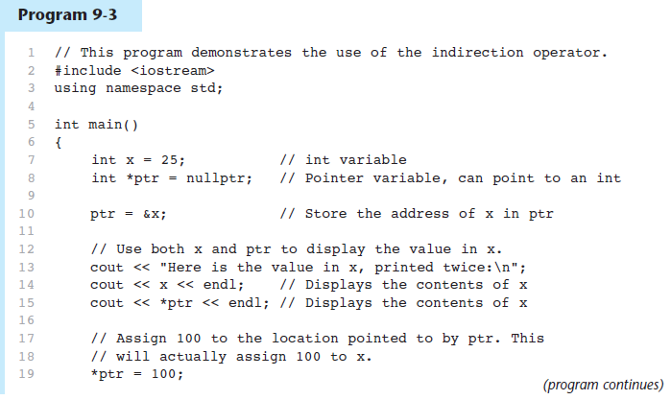
The Dereference (Indirection) Operator in Program 9-3

Slide 28
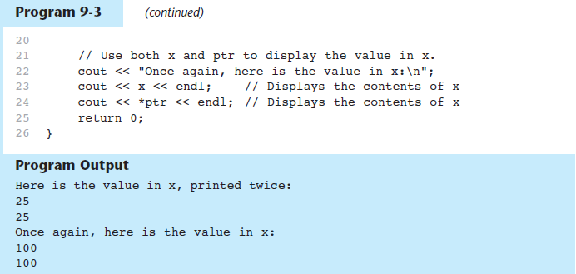
The Dereference (Indirection) Operatorin Program 9-3

Slide 29
Exercise 1
Design a program, which should prompt the user to enter two integers and then swap their values using pointers and the dereference operator

Slide 30
Pointer Operators
#include <iostream>
using namespace std;
int main(void)
{
int a; /* a is an integer */
int *aPtr; /* aPtr is a pointer to an integer */
a = 7;
aPtr = &a; /* aPtr set to address of a */
cout << "The address of a is “ << &a <<
"\nThe value of aPtr is “ << aPtr ;
// &a and aPtr have the same value
char x; // declaration of variable x as a character
cin >> x; // entering a value of x from a keyboard
return 0;
}

Slide 31
Pointer Operators
#include <iostream>
using namespace std;
int main(void)
{
int a; /* a is an integer */
int *aPtr; /* aPtr is a pointer to an integer */
a = 7;
aPtr = &a; /* aPtr set to address of a */
cout << "Showing that * and & are complements of each other:\n” << “&*aPtr = “ << &*aPtr << “\n*&aPtr = “ << *&aPtr );
return 0;
}

Slide 32
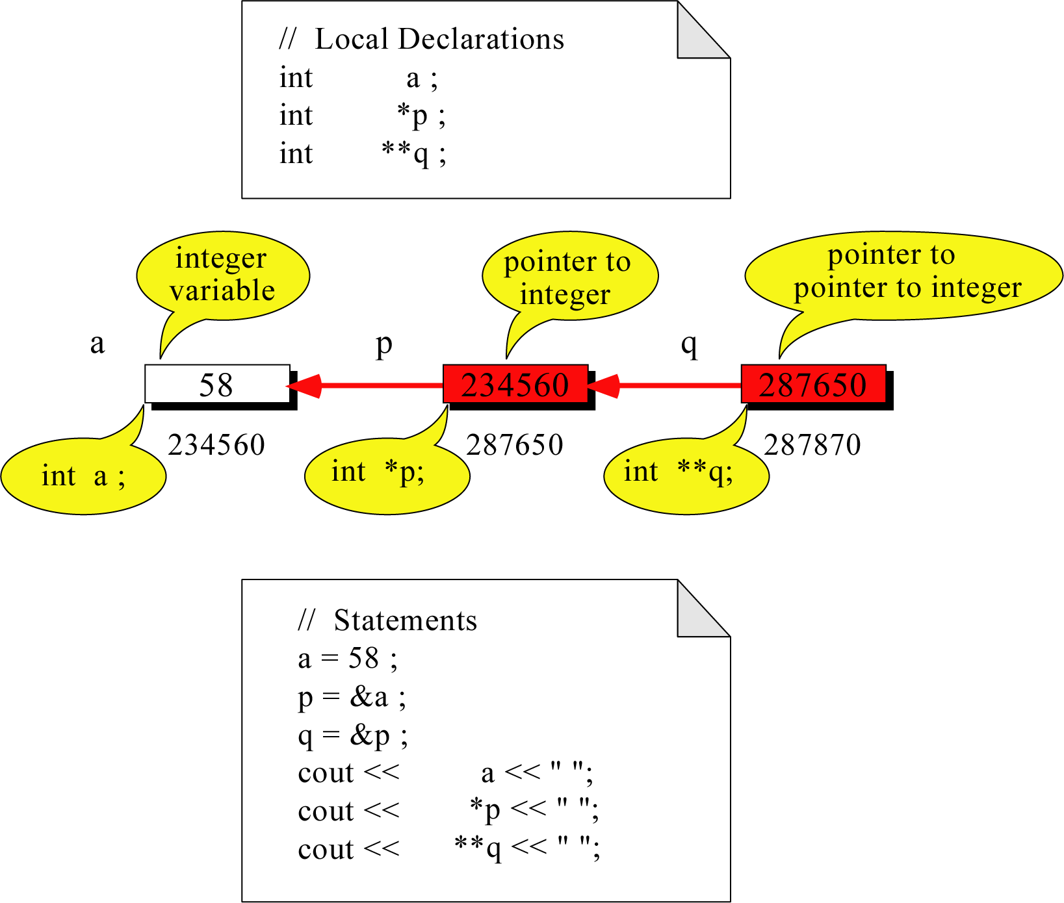
Pointer to Pointer
What is the output?
58 58 58

Slide 33
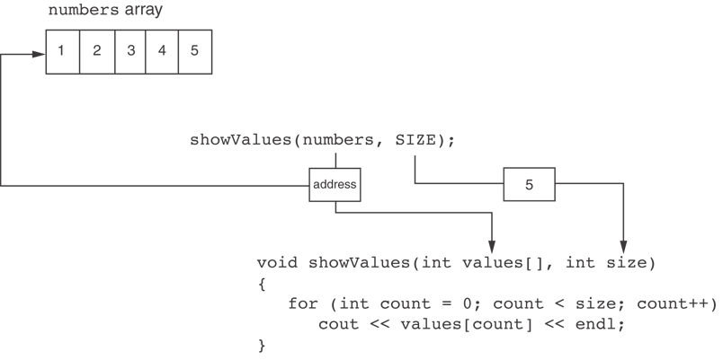
Something Like Pointers : Arrays
The values parameter, in the showValues function, points to the numbers array.
C++ automatically stores the address of numbers in the values parameter.

Slide 34
The Relationship Between Arrays and Pointers
Array name is starting address of array
int vals[] = {4, 7, 11};
cout << vals; // displays
// 0x4a00
cout << vals[0]; // displays 4
4 | 7 | 11
starting address of vals: 0x4a00

Slide 35
The Relationship Between Arrays and Pointers
Array name can be used as a pointer constant:
int vals[] = {4, 7, 11};
cout << *vals; // displays 4
Pointer can be used as an array name:
int *valptr = vals;
cout << valptr[1]; // displays 7

Slide 36
Array Name is a pointer constant
#include <iostream>
using namespace std;
void main (){
int a[5];
cout << "Address of a[0]: " << &a[0] << endl
<< "Name as pointer: " << a << endl;
}
Result:
Address of a[0]: 0x0065FDE4
Name as pointer: 0x0065FDE4

Slide 37
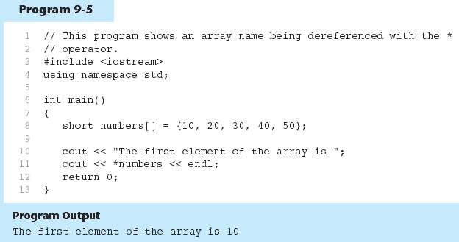
The Array Name Being Dereferenced in Program 9-5

Slide 38
Array Access
Array elements can be accessed in many ways:
Array access method | Example
array name and [] | vals[2] = 17;
pointer to array and [] | valptr[2] = 17;
array name and subscript arithmetic | *(vals + 2) = 17;
pointer to array and subscript arithmetic | *(valptr + 2) = 17;

Slide 39
Array Access
Conversion: vals[i] is equivalent to *(vals + i)
No bounds checking performed on array access, whether using array name or a pointer

Slide 40
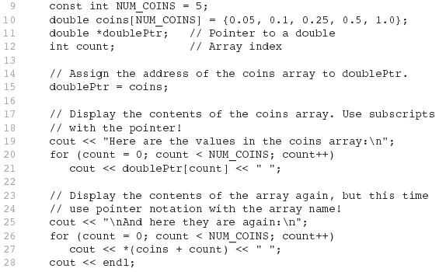

From Program 9-7

Slide 41
Pointer and Array
When an array is declared, the name of the array is actually a pointer to the first element in the array. As a consequence, array parameters are always passed to a function by reference
table[6] = {16, 21, 8, 3, -7, 9};
→ This is the same as following:
*(table + 0) = 16; // or table[0] = 16; *(table + 1) = 21; // or table[1] = 21; *(table + 2) = 8; // or table[2] = 8; *(table + 3) = 3; // or table[3] = 3; *(table + 4) = -7; // or table[4] = -7; *(table + 5) = 9; // or table[5] = 9;
Therefore, *(table + i) is the same as the table[i], where i = 0 to 5

Slide 42
Accessing Pointer Data
#include <iostream>
using namespace std;
int main()
{
char a[4] =”HAY";
cout << a[0] << "\n"; //display 0th element of an array
cout << *a << "\n"; //a is a character array. it prints 'H' which is // first element of an array
cout << a; //a is a pointer to an array of characters
cout << "\n";
cout << *(a+1) << "\n";
cout << *(a+2) << "\n";
return 0;
}

Slide 43
Pointer Arithmetic
Operations on pointer variables:
Operation | Example int vals[]={4,7,11}; int *valptr = vals;
++, -- | valptr++; // points at 7 valptr--; // now points at 4
+, - (pointer and int) | cout << *(valptr + 2); // 11
+=, -= (pointer and int) | valptr = vals; // points at 4 valptr += 2; // points at 11
- (pointer from pointer) | cout << valptr–val; // difference //(number of ints) between valptr // and val

Slide 44
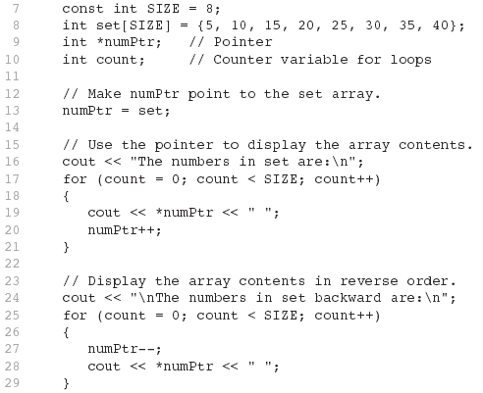

From Program 9-9

Slide 45
Initializing Pointers
Can initialize at definition time:
int num, *numptr = &num;
int val[3], *valptr = val;
Cannot mix data types:
double cost;
int *ptr = &cost; // won’t work
Can test for an invalid address for ptr with:
if (!ptr) ...

Slide 46
Comparing Pointers
Relational operators (<, >=, etc.) can be used to compare addresses in pointers
Comparing addresses in pointers is not the same as comparing contents pointed at by pointers:
if (ptr1 == ptr2) // compares
// addresses
if (*ptr1 == *ptr2) // compares
// contents

Slide 47
Pointers as Function Parameters
A pointer can be a parameter
Works like reference variable to allow change to argument from within function
Requires:
asterisk * on parameter in prototype and heading
void getNum(int *ptr); // ptr is pointer to an int
asterisk * in body to dereference the pointer
cin >> *ptr;
address as argument to the function
getNum(&num); // pass address of num to getNum

Slide 48
Example
void swap(int *x, int *y)
{ int temp;
temp = *x;
*x = *y;
*y = temp;
}
int num1 = 2, num2 = -3;
swap(&num1, &num2);

Slide 49
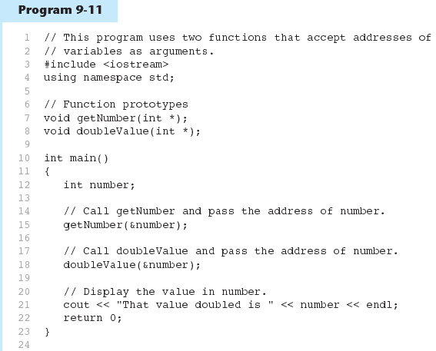
(Program Continues)

Slide 50
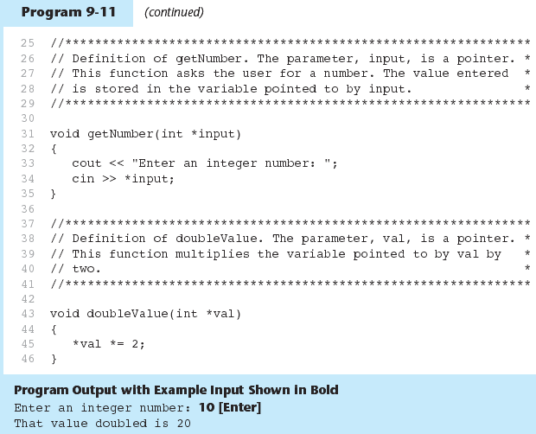

Slide 51
Array of Pointers & Pointers to Array
a
p
b
c
An array of Pointers
A pointer to an array
int a = 1, b = 2, c = 3;
int *p[5];
p[0] = &a;
p[1] = &b;
p[2] = &c;
int list[5] = {9, 8, 7, 6, 5};
int *p;
P = list;//points to 1st entry
P = &list[0];//points to 1st entry
P = &list[1];//points to 2nd entry
P = list + 1; //points to 2nd entry

Slide 52
Initializing a pointer to point to a value – Dynamic memory allocation
Dynamic memory allocation
When it is needed to store a value (a variable) or a series of values (an array), it allocates memory
Once the data are no longer needed, we can deallocate the memory and make it available for some other data structures within the same program or for the system
new and delete operators are used

Slide 53
Dynamic Memory Allocation
Can allocate storage for a variable while program is running
Computer returns address of newly allocated variable
Uses new operator to allocate memory:
double *dptr = nullptr;
dptr = new double;
new returns address of memory location

Slide 54
Initializing a pointer to point to a value
Example:
p1 = new int;
*p1 = 25;
delete p1;
It does not need to initialize p1 to the address of a static variable
The new operator creates enough memory to hold an integer value pointed to by p1
Then, we stored the value 25 in that memory area
We can deallocate the same memory area by using the delete operator
The delete operator does not delete the pointer, it simply destroys the data to which the pointer points.

Slide 55
Example: Initializing a pointer to point to a value
#include <iostream>
using namespace std;
int main()
{
//define two pointers and a variable
int *p1;
int *p2;
int index;
//initialize pointer data statically
p1 = &index;
index = 10;
//initialize pointer data dynamically
p2 = new int;
*p2 = 20;
//display pointer data
cout << "\n\nThe contents of memory pointed to by p1 is: “ << *p1;
Cout << "\n\nThe contents of memory pointed to by p2 is: “ << *p2;
//deallocate memory pointed to by p2
delete p2;
cout<<"\n"<<endl;
return 0;
}

Slide 56
Dynamic Memory Allocation
Can also use new to allocate an array: const int SIZE = 25; arrayPtr = new double[SIZE];
Can then use [] or pointer arithmetic to access an array:
for(i = 0; i < SIZE; i++)
arrayptr[i] = i * i;
or
for(i = 0; i < SIZE; i++)
*(arrayptr + i) = i * i;
Program will terminate if not enough memory available to allocate

Slide 57
Releasing Dynamic Memory
Use delete to free dynamic memory:
delete fptr;
Use [] to free dynamic array:
delete [] arrayptr;
Only use delete with dynamic memory!

Slide 58
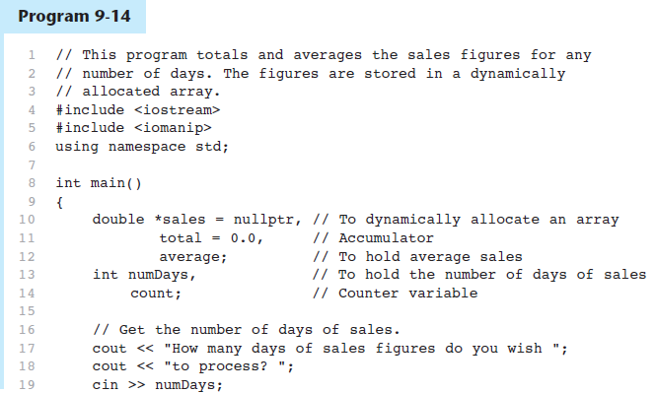
Dynamic Memory Allocation in Program 9-14

Slide 59
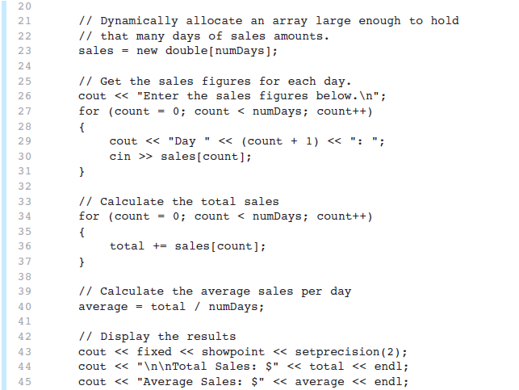
Dynamic Memory Allocation in Program 9-14
Program 9-14 (Continued)

Slide 60
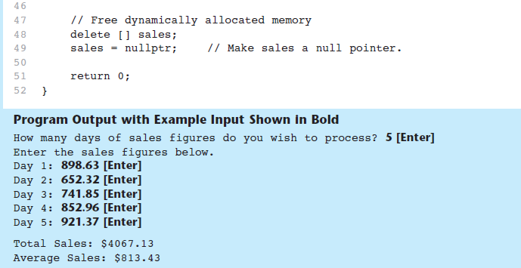
Dynamic Memory Allocation in Program 9-14
Program 9-14 (Continued)
Notice that in line 49 nullptr is assigned to the sales pointer. The delete operator is designed to have no effect when used on a null pointer.

Slide 61
Using Smart Pointers to Avoid Memory Leaks
In C++ 11, you can use smart pointers to dynamically allocate memory and not worry about deleting the memory when you are finished using it
Three types of smart pointer:
Must #include the memory header file:
In this book, we introduce unique_ptr:
unique_ptr
shared_ptr
weak_ptr
#include <memory>
unique_ptr<int> ptr( new int );

Slide 62
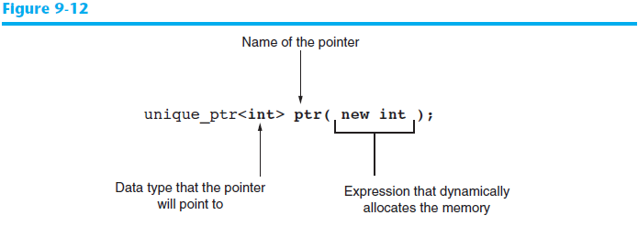
Using Smart Pointers to Avoid Memory Leaks
The notation <int> indicates that the pointer can point to an int .
The name of the pointer is ptr .
The expression new int allocates a chunk of memory to hold an int.
The address of the chunk of memory will be assigned to ptr.

Slide 63
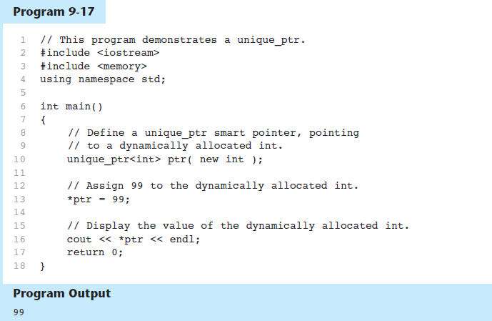
Using Smart Pointers in Program 9-17

Slide 64
Comparing Pointers
Relational operators (<, >=, etc.) can be used to compare addresses in pointers
Comparing addresses in pointers is not the same as comparing contents pointed at by pointers:
if (ptr1 == ptr2) // compares
// addresses
if (*ptr1 == *ptr2) // compares
// contents

Slide 65
Passing Arguments to Function
There are Two ways to pass arguments to a function
Call by value
Call by reference

Slide 66
Passing Arguments to Function by Value
#include <iostream>
using namespace std;
int cubeByValue(int n); // function prototype
int main(void)
{
int number = 5;
cout << "The original value of number is " << number;
number = cubeByValue(number); // Pass number by value to cubeByValue
cout << "\nThe new value of number is " << number << endl;
char x; / declaration of variable x as a character
cin >> x; // entering a value of x from a keyboard
return 0;
}
// Calculate and return cube of integer argument
int cubeByValue(int n)
{
return n * n * n;
}
Run:
The original value of number is 5
The new value of number is 125

Slide 67
Pointers as Function Parameters
A pointer can be a parameter
Works like reference variable to allow change to argument from within function
Requires:
asterisk * on parameter in prototype and heading
void getNum(int *ptr); // ptr is pointer to an int
asterisk * in body to dereference the pointer
cin >> *ptr;
address as argument to the function
getNum(&num); // pass address of num to getNum

Slide 68
Passing Arguments to Function by Reference
#include <iostream>
using namespace std;
void cubeByReference( int); // function prototype
int main(void)
{
int number = 5; // initialize number
cout << "The original value of number is " << number;
cubeByReference( &number ); // pass address of number to cubeByReference
cout << "\nThe new value of number after function call is " << number << endl;
char x; // declaration of variable x as a character
cin >> x; // entering a value of x from a keyboard
return 0;
}
// calculate cube of *nPtr: actually modifies number in main
void cubeByReference( int *nPtr )
{
*nPtr = *nPtr * *nPtr * *nPtr;
}
Run:
The original value of number is 5
The new value of number after function call is 125

Slide 69
Pointers as Function arguments and Parameters
#include <iostream>
using namespace std;
using namespace std;
void swap(int *p1, int *p2);
int main()
{
int value1 = 10;
int value2 = 20;
int *pointer2 = &value2;
int *pointer1 = &value1;
cout << "The value before the function call: " << value1 << " " << value2 << endl;
swap(pointer1, pointer2);
//swap values pointed by pointer1 and // pointer2);
cout << "The value after the function call: " << value1 << " " << value2 << endl;
return 0;
}
void swap(int *p1, int *p2)
{
int temp;
temp = *p1;
*p1 = *p2;
*p2 = temp;
}

Slide 70
Returning Pointers from Functions
Pointer can be the return type of a function:
int* newNum();
The function must not return a pointer to a local variable in the function
A function should only return a pointer:
to data that was passed to the function as an argument, or
to dynamically allocated memory – this method is used to return an array from the function – a pointer to the array dynamically created in the function should be returned

Slide 71
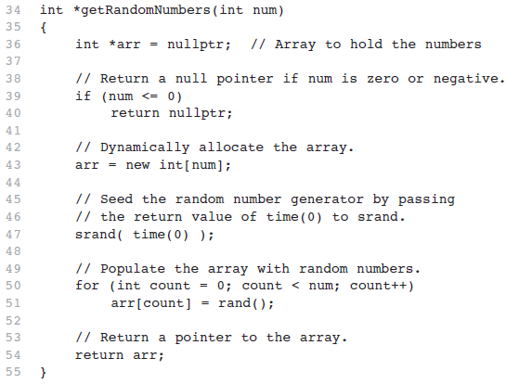
From Program 9-15 – Return a pointer to the array

Slide 72
Pointers to Constants
If we want to store the address of a constant in a pointer, then we need to store it in a pointer-to-const

Slide 73
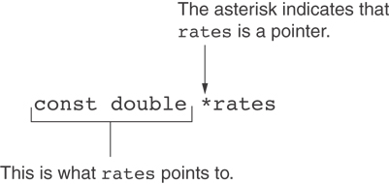
Declaration of a Pointer to Constant

Slide 74
Constant Pointers
A constant pointer is a pointer that is initialized with an address, and cannot point to anything else.
Example int value = 22; int * const ptr = &value;

Slide 75
Pointers to Constants
Example: Suppose we have the following definitions: const int SIZE = 6; const double payRates[SIZE] = { 18.55, 17.45, 12.85, 14.97, 10.35, 18.89 };
In this code, payRates is an array of constant doubles

Slide 76
Pointers to Constants
Suppose we wish to pass the payRates array to a function? Here's an example of how we can do it.
void displayPayRates(const double *rates, int size) { for (int count = 0; count < size; count++) { cout << "Pay rate for employee " << (count + 1) << " is $" << *(rates + count) << endl; } }
The parameter, rates, is a pointer to const double.

Slide 77
Array of Pointers
We can easily define an array that stores pointers, thus creating an array of pointers
Example:
char *ptr_Array[2];
ptr_Array[0] = “Dog”;
ptr_Array[1] = “Cat”;
First, define an array of pointers to character data.
Since array size is two, this array holds two pointers, or addresses.
Since an array name is always a pointer, this pointer points to the pointers contained in the array

Slide 78
Array of Pointers
*(ptr_Array[0])
ptr_Array
*ptr_Array
*(ptr_Array[0]+1)
Address of “Dog”
ptr_Array[0]
‘D’ | ‘o’ | ‘g’ | ‘\0’
Address of “Cat”
ptr_Array[1]
‘C’ | ‘a’ | ‘t’ | ‘\0’
*(ptr_Array[1]+2)
*(ptr_Array+1)
*(ptr_Array[1])

Slide 79
Array of Pointers
Arrays may contain pointers
A common use of an array of pointers is to form an array of strings, referred to simply as a string array
Each entry in the array is a string, but in C and C++, a string is essentially a pointer to its first character
Definition of string array desk, which might be useful in representing a class of contents const char *desk[4] = {“book”, “chair”, “keyboard”, “phone”};

Slide 80
Converting a String to Uppercase
Run:
The string before conversion is: cHaRaCters and $32.98
The string after conversion is: CHARACTERS AND $32.98
#include <iostream>
#include <ctype.h> // this library contains the toupper function
#using namespace std;
void convertToUppercase(char *sPtr); // prototype
int main(void)
char string[] = "cHaRaCters and $32.98"; // initial char array
cout << "The string before conversion is: " <<string << endl;
convertToUppercase(string);
cout << "The string after conversion is:" << string << endl;
return (0);
}
// convert string to uppercase letters
void convertToUppercase(char *sPtr)
{
while(*sPtr != '\0') // the loop continues until the null character \0 is met
{
*sPtr = toupper(*sPtr); // convert to uppercase
++sPtr; // increment of pointer to access the next character from a string
}
}

Slide 81
Printing a String One Character at a Time
#include <iostream>
using namespace std;
void printCharacters(const char *sPtr); // prototype
int main()
{
// initialize char array
char string[] = "print characters of a string";
cout << "The string is: " << endl;
printCharacters(string);
return 0;
}
// sPtr is a "read-only" pointer – it is declared as a constant
void printCharacters(const char *sPtr)
{
for(;*sPtr != '\0';++sPtr) // no initialization
// the loop continues until the null character \0 is met
{
cout << *sPtr << ' ';
}
}
Run:
The string is:
p r i n t c h a r a c t e r s o f a s t r i n g

